Slide 1
Employee Data Analysis using Excel
STUDENT NAME - R SAHANA
NM ID - F511DFFCE9E73C29F554F11B8FA76E06
REGISTER NO – 312216020
DEPARTMENT - B.COM GENERAL
COLLEGE - SHRI SHANKARLAL SUNDARBAI SHASUN JAIN COLLEGE FOR WOMEN

Slide 2
PROJECT TITLE
Employee Performance Analysis using Excel

Slide 3


AGENDA
Problem Statement
Project Overview
End Users
Our Solution and Proposition
Dataset Description
Modelling Approach
Results and Discussion
Conclusion
3/21/2024 Annual Review

Slide 4

PROBLEM STATEMENT
We need a comprehensive solution to collect, analyse and interpret relevant data on employee performance, providing actionable insights to enhance productivity and employee growth.

Slide 5

PROJECT OVERVIEW
This project aims to develop a comprehensive framework to measure and evaluate individual and team performance accurately.

Slide 6
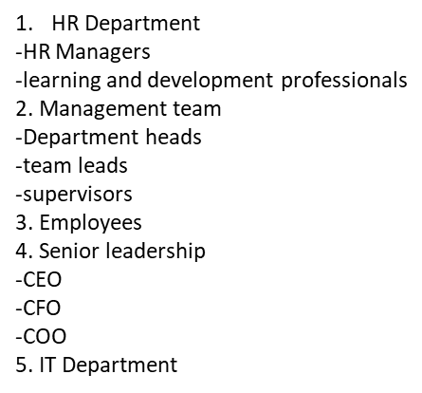

WHO ARE THE END USERS?
HR Department
-HR managers
-Learning and development professionals
2. Management Team
-Department heads
-Team leads
-Supervisors
3. Employees
4. Senior Leadership
-CEO
-CFO
-COO
5. IT Department

Slide 7

OUR SOLUTION AND ITS VALUE PROPOSITION
Conditional Formatting - Missing
Filter – Remove
Formula - Performance
Pivot Table - Summary
Graph – Data Visualization

Slide 8
DATASET DESCRIPTION
Employee = Kaggle
26 – Features
9 – Features
Emp ID Num
Performance level
Gender – Female Male
Employee rating – Num

Slide 9

THE "WOW" IN OUR SOLUTION
* Performance Level = IFS(Z8>=5,”VERY HIGH”,Z8>=4,”HIGH”,Z8>=3,”MED”,TRUE,”LOW”)
3/21/2024 Annual Review
9

Slide 10
MODELLING
DATA COLLECTION
FEATURE COLLECTION
DATA CLEANING
PERFORMANCE LEVEL
SUMMARY
10

Slide 11
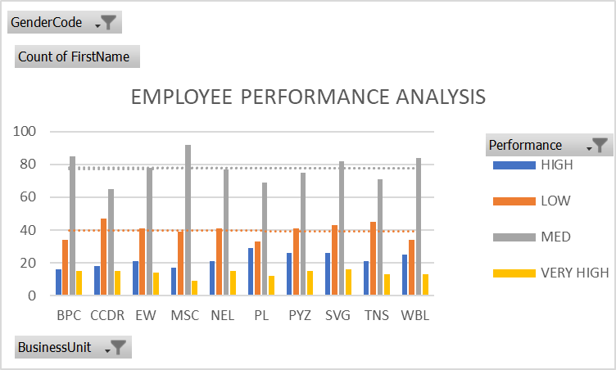
RESULTS
11

Slide 12
CONCLUSION
In conclusion, the Employee Performance Analysis project aims to enhance organisational productivity, employee engagement and data driven decision making by providing actionable insights into employee performance, development and growth.

